Slide 1
Introduction of the NWChem software
Daniel Mejia-Rodriguez,
Edoardo Aprà & Niri Govind
2023 CyberWorkshop

Slide 2




Environmental Molecular Sciences
Laboratory (EMSL)
https://www.emsl.pnnl.gov/
A U.S. Department of Energy national user facility
Molecular-level understanding of physical, chemical, and biological processes
Addresses DOE-BER environmental and energy production challenges
~650 scientific users annually from academia, national labs, and industry
150+ state-of-the-art and support instruments
Notes:
OPTIONAL - for use with S&T and general audiences interested in using EMSL facilities and capabilities, environmental management, or relevant sponsor groups
EMSL’s environmental and energy research areas include atmospheric aerosols, feedstocks, global carbon cycling, biogeochemistry, subsurface science, and energy materials. Scientists can propose research that utilizes any of EMSL’s 150+ experimental instruments—including mass spectrometers, microscopes, nuclear magnetic resonance spectrometers, and surface characterization tools—or its high-performance supercomputer, typically at no cost through a variety of proposal opportunities.
Website: https://www.emsl.pnnl.gov/emslweb/about

Slide 3



NWChem: Background
NWChem is part of the Molecular Science Software Suite
Designed and developed to be a highly efficient and portable Massively Parallel computational chemistry package
Provides computational chemistry solutions that are scalable with respect to chemical system size as well as MPP hardware size
Notes:
Development of nwchem was possible thanks to the concerted effort of domain scientists and computer scientisct

Slide 4
NWChem Overview
Core development activity at EMSL/PNNL
Designed for parallel architectures
Emphasis on modularity, portability, and integration
Portable – runs on a wide range of computers
Supercomputer to Mac or PC with Windows
Uses Global Arrays/ARMCI for parallelization
NWChem 7.2.0 is open-source and freely available
https://nwchemgit.github.io/
http://github.com/nwchemgit/nwchem

Slide 5
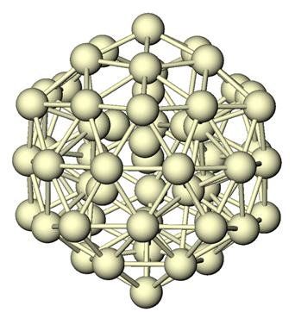
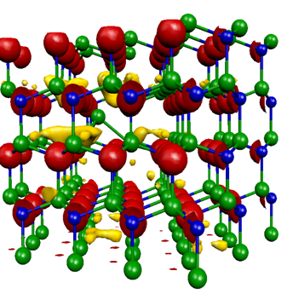
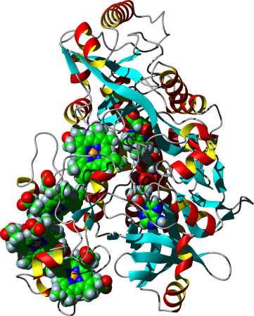
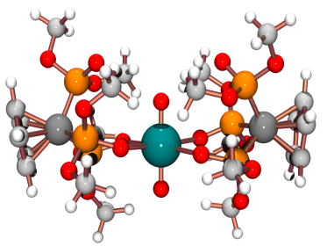
NWChem Science Capabilities
Provides major modeling and simulation capability
for molecular science
Broad range of molecules, including biomolecules, nanoparticles and heavy elements
Electronic structure of molecules (non-relativistic, relativistic, ECPs, first and second derivatives)
Solid state capability (DFT plane-wave, CPMD)
Molecular dynamics, molecular mechanics
About 340/year publications citing NWChem

Slide 6




NWChem’s core developer team
Edoardo Aprà
DFT & HPC
Eric Bylaska
Plane wave methods
Niri Govind
DFT
Karol Kowalski
Correlated Methods
Daniel Mejía-Rodríguez
DFT/GW
Marat Valiev
QM/MM
Notes:
Points of contact if something doesn’t work

Slide 7
NWChem methodologies overview
NWChem brings a full suite of methodologies to solve large scientific problems
High Accuracy Methods → MP, CC, EOMCC, MRCC
Ground & Excited States & Linear response
Gaussian-based DFT/TDDFT
Ground & Excited States, Optimization, Properties (NMR, Electric field gradient, linear response,…)
Plane wave based DFT
Car-Parinello MD (CPMD), Band Structure, Optimization, etc.
Molecular Dynamics, Molecular Mechanics
Integrated Methodologies → QM/MM
Scripting → Python

Slide 8
NWChem Structure
Generic
Tasks
Object-oriented design
abstraction, data hiding, APIs
Parallel programming model
non-uniform memory access, Global Arrays, MPI
Infrastructure
GA, Parallel I/O, RTDB, MA, ...
Program modules
communication only through the database
persistence for easy restart
Energy, structure, …
SCF energy, gradient, …
Molecular
Calculation
Modules
DFT energy, gradient, …
MD, NMR, Solvation, …
Run-time database
Optimize, Dynamics, …
Molecular
Modeling
Toolkit
Basis Set Object
Geometry Object
Integral API
PeIGS
...
...
Parallel IO
Molecular
Software
Development
Toolkit
Memory Allocator
Global Arrays
Notes:
More understanding will come during afternoon session, Application programming interface
Make sure that the GA working
RTDB can be used at any time by any module which makes the integration of various methodologies relatively easy task

Slide 9
NWChem: Ground, Excited-state & response properties of molecular systems
Electronic structure methods for single point calculations
Geometry optimization and transition state search
Vibrational HF and DFT
Spectroscopic properties (UV/Vis, IR, Raman, X-ray, NMR, EPR, non-linear optical properties)
Chemical reactions in solutions: solvation models
Relativistic effects
Dynamics on a ground state potential energy surface
Free Energy Sampling Techniques
partial atomic charges from Electrostatic Potential (ESP)

Slide 10
NWChem: Gaussian DFT
Gaussian based DFT → Finite systems (molecules, clusters, nanostructures)
Wide range of local and non-local exchange-correlation functionals
LDA & GGA XC functionals
Wide range of hybrid functionals (B3LYP, PBE0, HF exchange, …)
Meta-GGA functionals
Minnesota functionals (M05, M06, M11, etc …)
Range separated functionals
DFT + D implementation (long-range empirical vdW)
Spin-orbit DFT
ECP, ZORA, DK
Constrained DFT
IR frequencies
Linear-response & Real-time TDDFT TDDFT for excited states → Optical spectroscopy (UV/Vis, XAS, …)
Various properties (NMR, Linear response, Raman,…)

Slide 11
Coupled Cluster
Closed shell coupled cluster [CCSD and CCSD(T)]
Tensor contraction engine (TCE)
Spin-orbital formalism with RHF, ROHF, UHF reference
CCSD,CCSDT, …
CCSD(T), CR-CCSD(T), …
EOMCCSD,EOMCCSDT
Linear response CC (polarizabilities, hyperpolarizabilities)
Active-space CCSDt/EOMCCSDt
Multi-reference CC : BW-MRCCSD, Mk-MRCCSD, BW-MRCCSD(T), Mk-MRCCSD(T)
NWChem: High Accuracy Methods

Slide 12
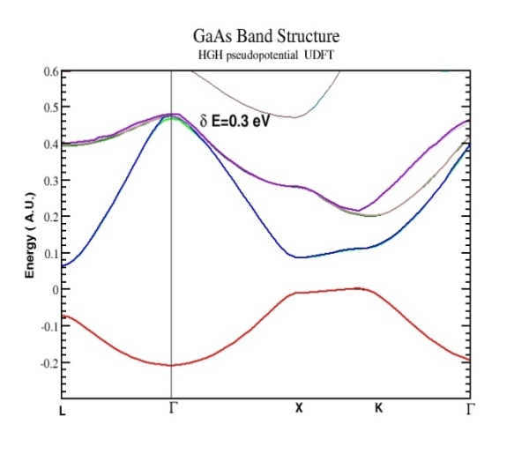
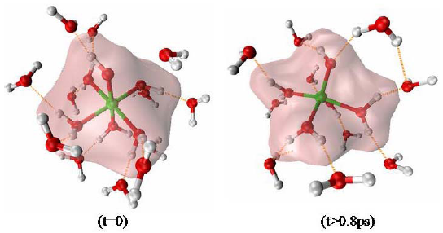
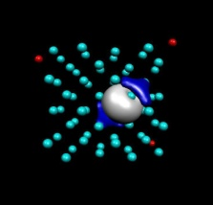

NWChem: Plane wave (1)
Plane wave density functional theory
Gamma point pseudopotential and projector augmented wave
Band structure (with spin-orbit ZORA)
Extensive dynamics functionality with Car-Parrinello
AIMD QM/MM molecular dynamics, e.g. SPC/E,CLAYFF solid state MD
Various exchange-correlation functionals
LDA, PBE96, PBE0, B3LYP
Exact exchange
SIC and OEP
Spin-Orbit splitting in GaAs
Car-Parrinello provides evidence for five-coordinated Al(H₂O)₄OH²⁺
Swaddle et al, Science, 2005
SIC localization
Notes:
QM/MM capabilities: pt charges, L-J. spring. Etc …
SIC self interaction correction
OEP optimized effective potential

Slide 13
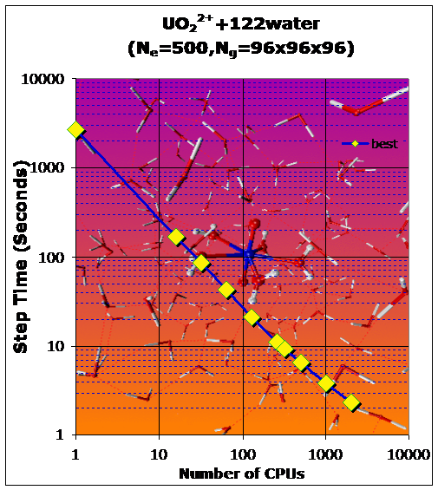
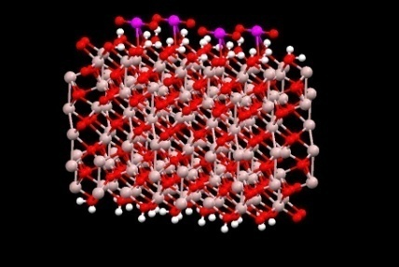
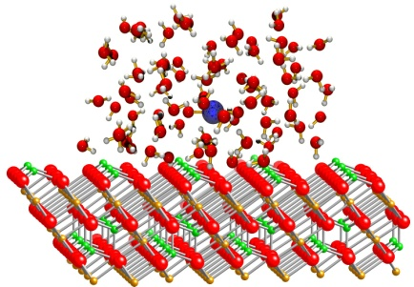
NWChem: Plane wave (2)
Can handle charged systems
A full range of pseudopotentials and a pseudopotential generator
A choice of state-of-the-art minimizers
Can also do plane-wave QM/MM
Car-Parrinello plane wave performance, PBE96 GGA Functional, -300 K thermostat, 0.121 fs time step, 122 water molecules-15.6 Å box
Uranyl on a hydroxylated Al₂O₃ surface
Uranyl in solution interacting with iron oxide

Slide 14
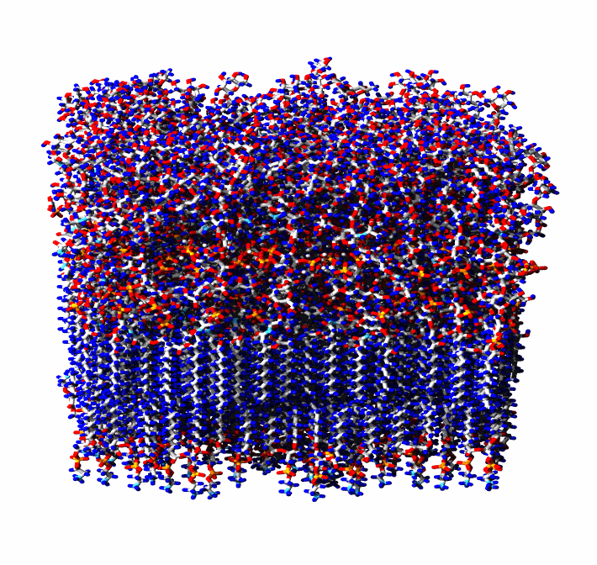
NWChem: Molecular Dynamics
Molecular dynamics
Charmm and Amber force fields
Various types of simulations:
Energy minimization
Molecular dynamics simulation including ab initio dynamics
Free energy calculation
Multiconfiguration thermodynamic integration

Slide 15

NWChem: Hybrid QM/MM
Seamless integration of molecular dynamics with Coupled Cluster and DFT
Optimization and transition states
QM/MM Potential of Mean Force
Modeling properties at finite temperature
Excited States with EOMCC, TDDFT
Polarizabilities with linear response CC
NMR chemical shift with DFT
QM/MM for pathways
NEB-QM/MM approach for Reaction Pathway Calculations
Free energy calculation
Notes:
Modular structure of NWChem enabled us to integrate several modules
NEB nudged elastic band methods
Mol properties at finite temperatures and pressures
In the ideal work everything should be treated quantum mechanically (but we are not living in the ideal workd) and there is no need for doing that.
Interesting happens often happen at the local scale (active center

Slide 16
NWChem: AIMD for Ground & Excited States
New Gaussian basis AIMD module
Compatible with all Gaussian basis function based electronic structure methods in NWChem
Will work with numerical gradients if analytical gradients are absent
Molecular systems, finite clusters
Velocity Verlet
NVE and NVT ensembles
Berendsen¹, Langevin², and stochastic velocity rescaling³
Standalone program provided to analyze trajectories
¹Berendsen, et al. J. Chem. Phys. 81, 3684–3690 (1984)
²Bussi, Parrinello, Phys. Rev. E 75, 056707 (2007)
³Bussi, et al. J. Chem. Phys. 126, 014101 (2007)
Notes:
Fourier transforms of the dipole and polarizability correlation functions in the time domain
Frequency-dependent molecular polarizability tensors for Raman analysis computed at every step in each of the trajectories in the velocity gauge at an incident wavelength of 800 nm to match with the excitation wavelength used in the experiments

Slide 17
NWChem: other functionality
Other functionality available in NWChem
NMR shielding and indirect spin-spin coupling
COSMO
ONIOM
Relativity through spin-orbit ECP, ZORA, and DK
Electron transfer
Vibrational SCF and DFT for anharmonicity
Module for dynamic nucleation theory Monte Carlo
Interface with VENUS for chemical reaction dynamics
Interface with POLYRATE, Python
Interface with NBO
Notes:
Conductor like screening model (COSMO)
ONIOM (our own n-layered integrated molecular orbital and molecular mechanics

Slide 18
NWChem: Interfaces to other programs
Recent Blah blah
XTB
Plumed
libxc
Simint
OpenBLAS
Scalapack
QIS
Molden output
Notes:
Conductor like screening model (COSMO)
ONIOM (our own n-layered integrated molecular orbital and molecular mechanics

Slide 19
EMSL Arrows: Making molecular modeling accessible
EMSL Arrows is a very simple way to use NWChem.
The user emails chemical reactions to arrows@emsl.pnnl.gov and
then an email is sent back with thermodynamic, reaction pathway (kinetic), spectroscopy, and other results.

Slide 20
EMSL Arrows can calculate
DFT, PSPW, BAND, HF, MP2, CCSD(T)
Reaction thermodynamics for molecular systems
Reaction paths for molecular systems
IR, Raman spectra, UV-vis for molecular systems, phonon spectra for materials systems
NMR and EXAFS spectra for molecular and materials systems
Energetics, structures, and band structures of crystals using the Crystal Open Database
A variety of datafiles can be returned including XYZ files, CIF files, NWChem output files

Slide 21
NWChem Best Practices – Installation Tips
Packages available from Linux distributions (e.g. RPM)
Mostly well built and read for desktop computers
Container images (Docker, Singularity, Shifter, Podman)
Conda
Homebrew
When starting from source, be sure of
Use the most efficient GA/ARMCI
Link with optimized BLAS and Scalapack
Play nicely with compilers …
Validate installation with Q&A suite
Follow the compilation hints from the NWChem website
We can help you, please contact us at
https://nwchemgit.github.io

Slide 22
NWChem Best Practices – Input files
Keep it simple
Most of the defaults are suited for most cases
Use direct algorithms
HF/DFT direct algorithm prevent I/O
Default is I/O that might not be suitable for your HW
Use memory based algorithms (a.k.a in-core)
When enough aggregate memory is available,

Slide 23
NWChem Input Basics
Minimal input (all defaults)
geometry
n 0.00 0.00 0.00
n 0.00 0.00 1.08
end
basis
n library cc-pvdz
end
task scf
Performs a closed-shell SCF on the N₂ molecule
Notes:
This slide has an example of minimal input. You specify the geometry, specify the basis set, and tell NWChem to do an SCF. This is a complete input file. The default task is energy, so this will give the SCF energy.

Slide 24
Geometry Input: Units
Input can be in Angstrom
or atomic units
geometry # units are in angstroms
C 0 0 0
H 0 0.9885 -0.4329
H 0 –0.9885 0.4329
end
geometry units au # change units to a.u.
C 0 0 0
H 0 1.868 -0.818
H 0 -1.868 0.818
end
Notes:
This slide has an example of minimal input. You specify the geometry, specify the basis set, and tell NWChem to do an SCF. This is a complete input file. The default task is energy, so this will give the SCF energy.

Slide 25
Geometry Input: Symmetry
CH2 molecule with C_{2v} symmetry
C₆₀ with I_{h} symmetry
geometry units au #input using symmetry
C 0 0 0
H 0 1.868 -0.818
symmetry c2v
end
geometry #bonds = 1.4445 and 1.3945 Angstrom
symmetry Ih
c -1.2287651 0.0 3.3143121
end
Notes:
This slide has an example of minimal input. You specify the geometry, specify the basis set, and tell NWChem to do an SCF. This is a complete input file. The default task is energy, so this will give the SCF energy.

Slide 26
Geometry Input: autosym and autoz
By default NWChem will:
Attempt to find symmetry if none is specified
Attempt to build a z-matrix from cartesian coordinates (for the geometry optimization)
Center the molecule in the reference frame
The input below turns off these three steps (not recommended!)
geometry noautoz noautosym nocenter
C 0 0 0
H 0 0.9885 -0.4329 #Angstroms
H 0 –0.9885 0.4329
end
Notes:
This slide has an example of minimal input. You specify the geometry, specify the basis set, and tell NWChem to do an SCF. This is a complete input file. The default task is energy, so this will give the SCF energy.

Slide 27
Geometry Input: zmatrix
Geometry can be specified using a z-matrix format
geometry
zmatrix
O
H1 O 0.95
H2 O 0.95 H1 108.0
end
end
Notes:
This slide has an example of minimal input. You specify the geometry, specify the basis set, and tell NWChem to do an SCF. This is a complete input file. The default task is energy, so this will give the SCF energy.

Slide 28
Geometry Input: zmatrix
Distances and angles can be specified with variables
geometry
zmatrix
O
H1 O doh
H2 O doh H1 ahoh
variables
ahoh 108.0
constant
doh 0.95
end
end
Notes:
This slide has an example of minimal input. You specify the geometry, specify the basis set, and tell NWChem to do an SCF. This is a complete input file. The default task is energy, so this will give the SCF energy.

Slide 29
Geometry Input: zcoord
Forcing internal coordinates (use with care …)
geometry
Si 0.0000E+00 0.0000E+00 0.0000E+00
H -0.9436E+00 -0.8807E+00 0.7319E+00
H 0.7373E+00 -0.8179E+00 -0.9932E+00
H -0.7835E+00 0.1038E+01 -0.7137E+00
Si 0.1699E+01 0.1556E+01 0.1695E+01
H 0.7715E+00 0.2377E+01 0.2511E+01
H 0.2544E+01 0.6805E+00 0.2539E+01
H 0.2514E+01 0.2381E+01 0.7713E+00
end
### fix the Si-Si distance to 4.0 angstroms ###
geometry adjust # initial state
zcoord
bond 1 4 4.00 r constant
end
end
Notes:
This slide has an example of minimal input. You specify the geometry, specify the basis set, and tell NWChem to do an SCF. This is a complete input file. The default task is energy, so this will give the SCF energy.

Slide 30
Geometry Input: system
Crystal lattice, used in plane wave code, for 3-D periodic systems (crystals)
geometry units angstroms center noautosym noautoz print
system crystal
lat_a 3.625d0 #diamond
lat_b 3.625d0
lat_c 3.625d0
alpha 90.0d0
beta 90.0d0
gamma 90.0d0
end
C -0.50000d0 -0.50000d0 -0.50000d0
C 0.00000d0 0.00000d0 -0.50000d0
C 0.00000d0 -0.50000d0 0.00000d0
C -0.50000d0 0.00000d0 0.00000d0
C -0.25000d0 -0.25000d0 -0.25000d0
C 0.25000d0 0.25000d0 -0.25000d0
C 0.25000d0 -0.25000d0 0.25000d0
C -0.25000d0 0.25000d0 0.25000d0
end
Notes:
This slide has an example of minimal input. You specify the geometry, specify the basis set, and tell NWChem to do an SCF. This is a complete input file. The default task is energy, so this will give the SCF energy.

Slide 31
Basis Set Input: Using libraries
Atoms can be defined by symbol and name
* (asterisk) can be used to state that all atoms in the system should be using the same basis set type
basis
O library cc-pvdz
H1 library cc-pvdz file /home/me/nwchem/libraries/
H2 library sto-3g
end
basis
* library cc-pvdz
end
Notes:
This slide has an example of minimal input. You specify the geometry, specify the basis set, and tell NWChem to do an SCF. This is a complete input file. The default task is energy, so this will give the SCF energy.

Slide 32
Basis Set Input: Explicit basis sets
Basis set input can be done with exponents and coefficients
basis spherical
H s
13.0100 0.019685
1.9620 0.137977
0.4446 0.478148
0.1220 0.501240
H s
0.1220 1.000000
H p
0.7270 1.000000
end

Slide 33
Basis Set Input: Explicit basis sets
Libraries and explicit input can be used together
Main library in sync with the obsolete Basis Set Exchange
https://bse.pnl.gov
Alternative library in sync with the current Basis Set Exchange
https://www.basissetexchange.org/
basis spherical
* library cc-pvdz
H p
0.007270 1.000000
end

Slide 34
Task Input
The Task directive tells NWChem what it should do
task scf # default is energy
task scf energy
task dft optimize
task dft saddle
task ccsd frequencies
task pspw optimize
task md dynamics
Notes:
This slide has an example of minimal input. You specify the geometry, specify the basis set, and tell NWChem to do an SCF. This is a complete input file. The default task is energy, so this will give the SCF energy.

Slide 35
Task Input
Tasks are preformed in sequence as listed in input
task scf energy
task dft optimize ignore # ignore if failed, go to next task
task dft saddle
task ccsd frequencies
Notes:
This slide has an example of minimal input. You specify the geometry, specify the basis set, and tell NWChem to do an SCF. This is a complete input file. The default task is energy, so this will give the SCF energy.

Slide 36
Restarting a calculation
To restart NWChem will need certain files, that should be saved in permanent directory
start ne
permanent_dir /users/me
geometry
ne 0 0 0
end
basis
ne library cc-pvdz
end
task scf
restart ne
permanent_dir/users/me
scf
thresh 1e-8
end
task scf
Notes:
This slide has an example of minimal input. You specify the geometry, specify the basis set, and tell NWChem to do an SCF. This is a complete input file. The default task is energy, so this will give the SCF energy.

Slide 37
Setting memory and charge keyword
If NWChem fails with an error asking for more memory, you can set it explicitly
Remember, memory is per processor!
By default, molecules have a neutral charge (0)
memory 2400 mb
charge -1
Notes:
This slide has an example of minimal input. You specify the geometry, specify the basis set, and tell NWChem to do an SCF. This is a complete input file. The default task is energy, so this will give the SCF energy.

Slide 38
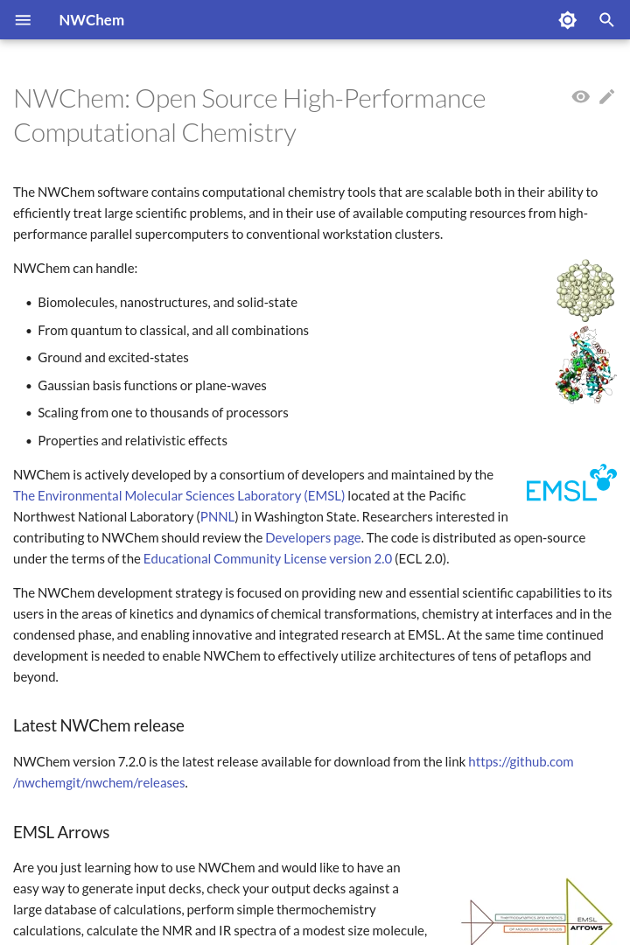
NWChem website
https://nwchemgit.github.io
Notes:
This slide has an example of minimal input. You specify the geometry, specify the basis set, and tell NWChem to do an SCF. This is a complete input file. The default task is energy, so this will give the SCF energy.

Slide 39
Github repository
https://github.com/nwchemgit/nwchem
Source code repository
Release files
Documentation in wiki format
Issue channel for bug reports
Notes:
This slide has an example of minimal input. You specify the geometry, specify the basis set, and tell NWChem to do an SCF. This is a complete input file. The default task is energy, so this will give the SCF energy.

Slide 40
Questions?

Slide 41
Thank you

